Slide 1
Pokemon Database
Leah Goldberg & John Chu

Slide 2



The Database - General Design
Based off of the fictional universe of Pokemon
4 tables
151Pokemon (151 rows)
Trainers (15 rows)
Pairs (65 rows)
Places (10 rows)

Slide 3
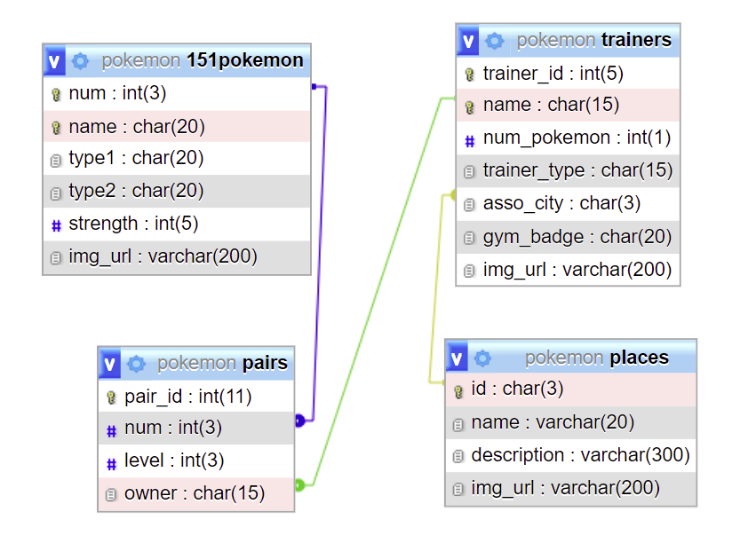
The Database - Relation Notation
POKEMON (num, name, type1, type2, strength, img_url)
TRAINER (trainer_id, name, num_pokemon, trainer_type, asso_city, gym_badge, img_url)
asso_city: foreign key, refers to ID in
PLACE, NULL value not allowed
PAIRS(pair_id, num, level, owner)
num: foreign key, refers to NUM in POKEMON,
NULL value not allowed
owner: foreign key, refers to NAME in
TRAINER, NULL value not allowed
PLACE(id, name, description, img_url)

Slide 4
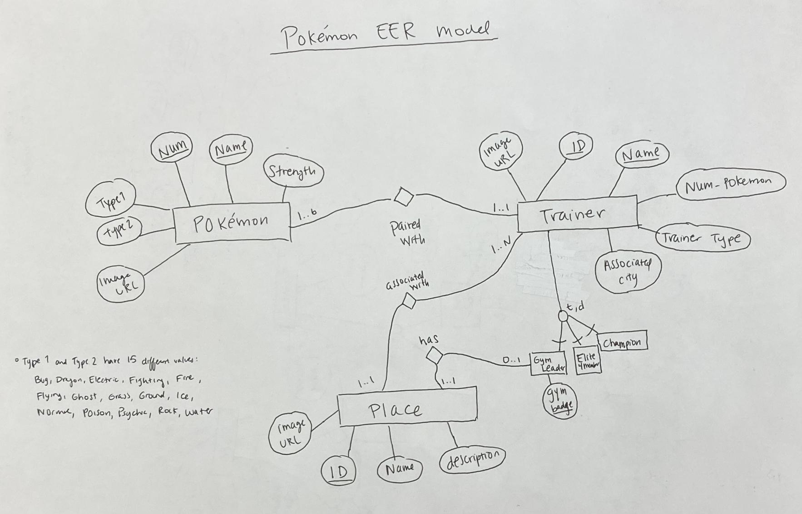
The Database - EER Model

Slide 5
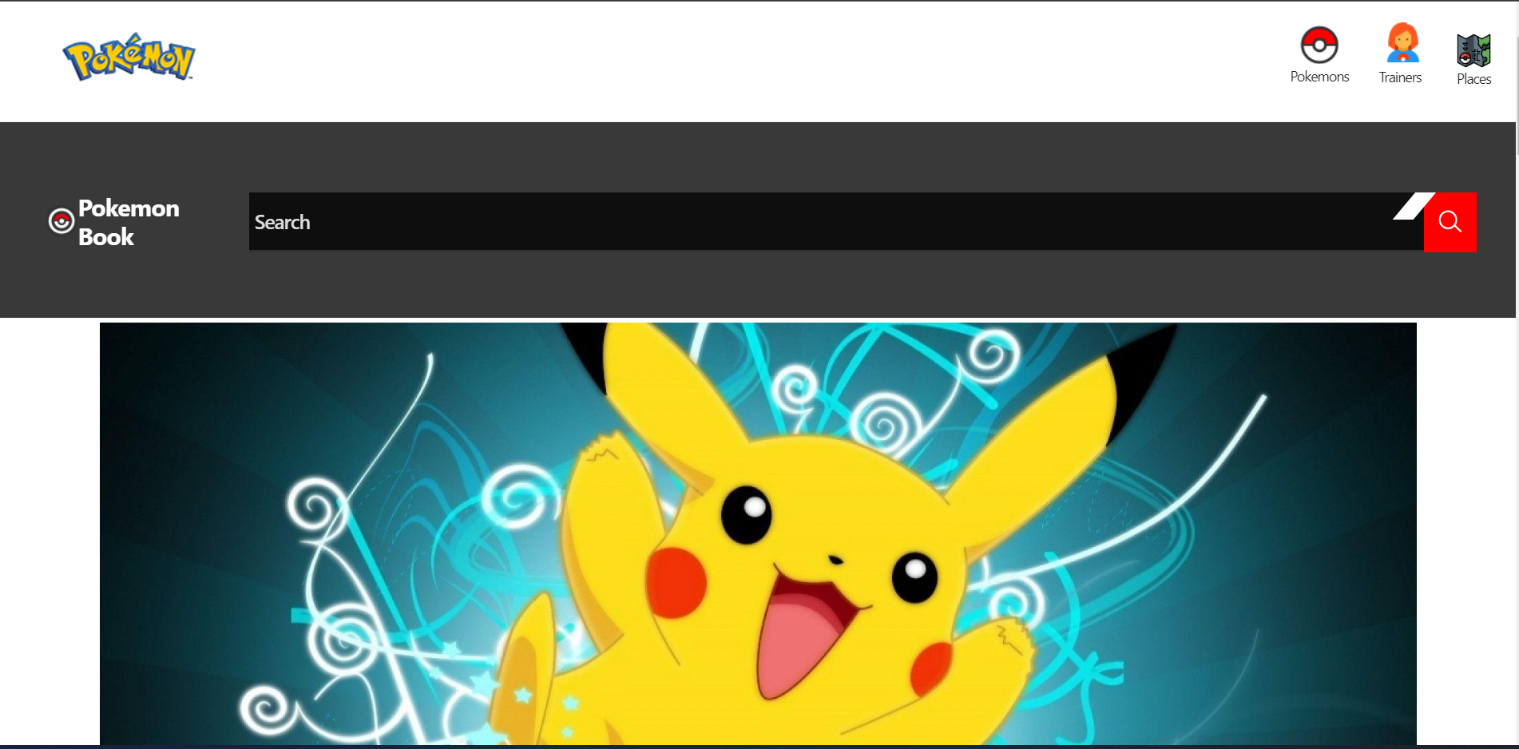
The Computer Program - Description
Dynamic webpage (brief technical details explained later)
3 main web pages
Search functionality

Slide 6



The Computer Program - 3 Main Web Pages: Pokemon
Displays (almost) all the information from the 151Pokemon Table
Filter by feature
Sort by number (default)
Sort by name (A-Z)
Sort by strength (low to high),
Sort by strength (high to low)

Slide 7
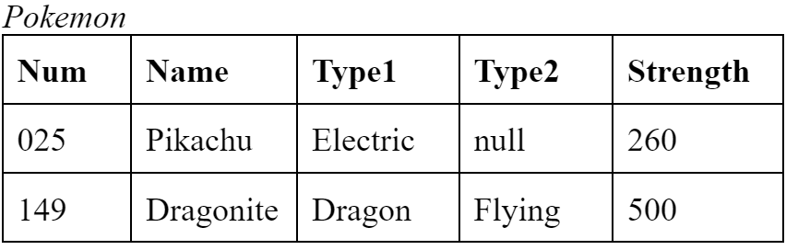
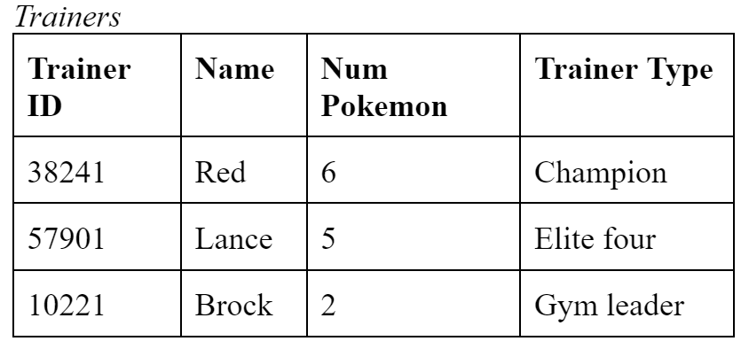
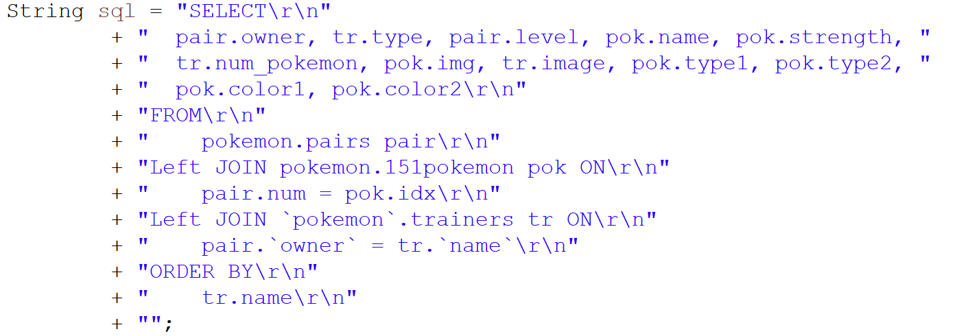
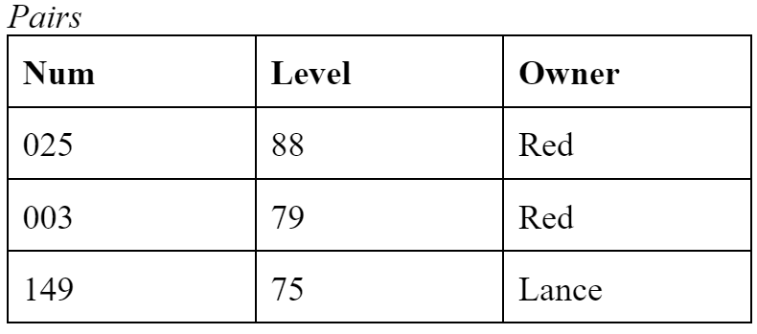
The Computer Program - 3 Main Web Pages: Trainers
Contains information from the Pairs table on each trainer and their Pokemon
Uses a JOIN query on Trainers, Pairs, and Pokemon to display the Pokemon that each trainer owns

Slide 8

The Computer Program - 3 Main Web Pages: Places
Contains name, place ID, description, and images of all the places in the Places table

Slide 9

The Computer Program - The Search Functionality
Users can search up any Pokemon, Trainer, or Place
Pokemon
By name (e.g. Pikachu)
By type (e.g. Grass)
Trainer
By name (e.g. Red)
By trainer type (e.g Gym leader)
Place
By name (e.g. Pallet Town)
By description (e.g. seaside)

Slide 10
Live Demo! :)

Slide 11

The Computer Program - Technical Notes
Dynamic website that runs on JSP (Java Server Page)
Connects to Pokemon database schema via JDBC and MySQL Workbench (XXAMP is broken on both of our computers)
Model, Viewer, and Controller (MVC)
Data Transfer Object (DTO) Data Access Object (DAO)
Prepared statements

Slide 12

Overall Experience - General Thoughts
Enjoyed creativity and innovation of the project
Valuable learning experience
Passion for Pokemon drove us to complete this project enthusiastically

Slide 13

Overall Experience - Difficulties
Creating the database & SQL queries were straightforward
CSS aspect - properly rendering pages
Web server configurations
Project Facet
Tomcat
STS Tools
JDBC
Dynamic components
HTML/CSS, JavaScript, JQuery, JSTL, Java, JSP

Slide 14

Future Implementations - Additional Features
Developing the Pokemon Project with a community mindset…
Expanding the database
Pokemon Blog
Strengthening searching
Commercializing Pokemon goods
Admin Page (users with special features)

Slide 15

END
Thank you for listening!
Questions?

